Slide 1
Displaying Data from Multiple Tables
(Joining – one of the 3 relational operators)

Slide 2
Objectives
After completing this lesson, you should be able to do the following:
Write SELECT statements to access data from more than one table using equijoins and nonequijoins
Join a table to itself by using a self-join
View data that generally does not meet a join condition by using outer joins
Generate a Cross join of all rows from two or more tables
Notes:
Objectives
This lesson explains how to obtain data from more than one table. A join is used to view information from multiple tables. Therefore, you can join tables together to view information from more than one table.
Note: Information on joins is found in the section on SQL Queries and Subqueries: Joins in Oracle Database SQL Language Reference 11g, Release 1 (11.1).

Slide 3
Lesson Agenda
Types of JOINS and their syntax
Natural join:
NATURAL JOIN clause
USING clause
ON clause
Self-join
Nonequijoins
OUTER join:
LEFT OUTER join
RIGHT OUTER join
FULL OUTER join
Cartesian product
Cross join

Slide 4

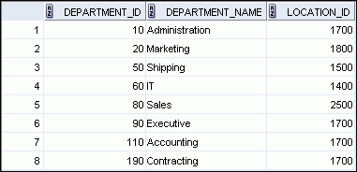

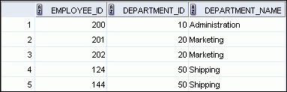

Obtaining Data from Multiple Tables
EMPLOYEES
DEPARTMENTS
…
…
Notes:
Obtaining Data from Multiple Tables
Sometimes you need to use data from more than one table. In the example in the slide, the report displays data from two separate tables:
Employee IDs exist in the EMPLOYEES table.
Department IDs exist in both the EMPLOYEES and DEPARTMENTS tables.
Department names exist in the DEPARTMENTS table.
To produce the report, you need to link the EMPLOYEES and DEPARTMENTS tables, and access data from both of them.

Slide 5
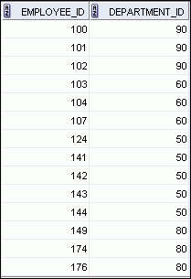
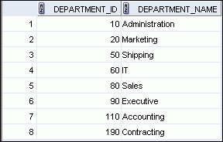
Equijoin
EMPLOYEES
DEPARTMENTS
Primary key
…
NOTE: The relationship between the EMPLOYEES and DEPARTMENTS tables is an equijoin; that is, values in the DEPARTMENT_ID column in both the tables must be equal. Frequently, this type of join involves primary and foreign key complements.
Equijoins are also called simple joins or inner joins.
Foreign key
Notes:
Joining Column Names
To determine an employee’s department name, you compare the value in the DEPARTMENT_ID column in the EMPLOYEES table with the DEPARTMENT_ID values in the DEPARTMENTS table. The relationship between the EMPLOYEES and DEPARTMENTS tables is an equijoin; that is, values in the DEPARTMENT_ID column in both the tables must be equal. Frequently, this type of join involves primary and foreign key complements.
Note: Equijoins are also called simple joins or inner joins.
NOTE: The relationship between the EMPLOYEES and DEPARTMENTS tables is an equijoin; that is, values in the DEPARTMENT_ID column in both the tables must be equal. Frequently, this type of join involves primary and foreign key complements.
Equijoins are also called simple joins or inner joins.

Slide 6
Types of Joins
Joins that are compliant with the SQL:1999 standard include the following:
Natural joins:
NATURAL JOIN clause
JOIN..USING clause
JOIN..ON clause
OUTER joins:
LEFT OUTER JOIN
RIGHT OUTER JOIN
FULL OUTER JOIN
Cross joins
Notes:
Types of Joins
To join tables, you can use a join syntax that is compliant with the SQL:1999 standard.
Note
Before the Oracle9i release, the join syntax was different from the American National Standards Institute (ANSI) standards. The SQL:1999–compliant join syntax does not offer any performance benefits over the Oracle-proprietary join syntax that existed in the prior releases. For detailed information about the proprietary join syntax, see Appendix C: Oracle Join Syntax.
The following slide discusses the SQL:1999 join syntax.

Slide 7
Joining Tables Using SQL:1999 Syntax
Use a join to query data from more than one table:
SELECT table1.column, table2.column
FROM table1
[NATURAL JOIN table2] |
[JOIN table2 USING (column_name)] |
[JOIN table2
ON (table1.column_name = table2.column_name)]|
[LEFT|RIGHT|FULL OUTER JOIN table2
ON (table1.column_name = table2.column_name)]|
[CROSS JOIN table2];
Notes:
Joining Tables Using SQL:1999 Syntax
In the syntax:
table1.column denotes the table and the column from which data is retrieved
NATURAL JOIN joins two tables based on the same column name
JOIN table2 USING column_name performs an equijoin based on the column name
JOIN table2 ON table1.column_name = table2.column_name performs an equijoin based on the condition in the ON clause
LEFT/RIGHT/FULL OUTER is used to perform OUTER joins
CROSS JOIN returns a Cartesian product from the two tables
For more information, see the section titled SELECT in Oracle Database SQL Language Reference 11g, Release 1 (11.1).

Slide 8
Qualifying Ambiguous Column Names
Use table prefixes to qualify column names that are in multiple tables.
(Oracle can tell which column you mean, and it runs faster.)
Example: e.department_id FROM employees e
Table alias for employees table
Notes:
Qualifying Ambiguous Column Names
When joining two or more tables, you need to qualify the names of the columns with the table name to avoid ambiguity. Without the table prefixes, the DEPARTMENT_ID column in the SELECT list could be from either the DEPARTMENTS table or the EMPLOYEES table. It is necessary to add the table prefix to execute your query. If there are no common column names between the two tables, there is no need to qualify the columns. However, using the table prefix improves performance, because you tell the Oracle server exactly where to find the columns.
However, qualifying column names with table names can be time consuming, particularly if the table names are lengthy. Instead, you can use table aliases. Just as a column alias gives a column another name, a table alias gives a table another name. Table aliases help to keep SQL code smaller, therefore using less memory.
The table name is specified in full, followed by a space and then the table alias. For example, the EMPLOYEES table can be given an alias of e, and the DEPARTMENTS table an alias of d.
Guidelines
Table aliases can be up to 30 characters in length, but shorter aliases are better than longer ones.
If a table alias is used for a particular table name in the FROM clause, then that table alias must be substituted for the table name throughout the SELECT statement.
Table aliases should be meaningful.
The table alias is valid for only the current SELECT statement.
Qualify the column name

Slide 9
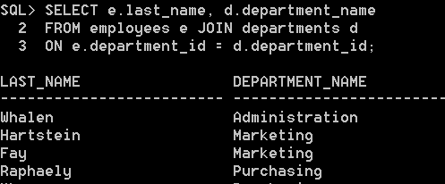
Table aliases
Also use table aliases to give a table a shorter name

Slide 10
Lesson Agenda
Types of JOINS: Equijoins
Natural join:
NATURAL JOIN clause
USING clause
ON clause
Self-join
Nonequijoins
OUTER join:
LEFT OUTER join
RIGHT OUTER join
FULL OUTER join
Cartesian product
Cross join

Slide 11
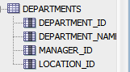
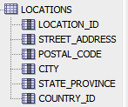
Natural Joins with NATURAL JOIN clause
The NATURAL JOIN clause requires
two tables must have one or more columns with the same name and compatible datatypes.
An equijoin is performed
If the “same name” columns have different data types, an error is returned.
Notes:
Creating Natural Joins
You can join tables automatically based on the columns in the two tables that have matching data types and names. You do this by using the NATURAL JOIN keywords.
Note: The join can happen on only those columns that have the same names and data types in both tables. If the columns have the same name but different data types, then the NATURAL JOIN syntax causes an error.

Slide 12
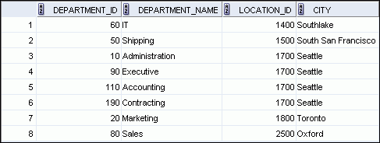
Natural Joins Oracle joins on the common column(s)
SELECT department_id, department_name,location_id, city
FROM departments NATURAL JOIN locations ;
The common column
Notes:
Retrieving Records with Natural Joins
In the example in the slide, the LOCATIONS table is joined to the DEPARTMENT table by the LOCATION_ID column, which is the only column of the same name in both tables. If other common columns were present, the join would have used them all.
Natural Joins with a WHERE Clause
Additional restrictions on a natural join are implemented by using a WHERE clause. The following example limits the rows of output to those with a department ID equal to 20 or 50:
SELECT department_id, department_name,
location_id, city
FROM departments
NATURAL JOIN locations
WHERE department_id IN (20, 50);

Slide 13
Common column may not be qualified
SELECT d.department_id, d.department_name, location_id,
l.city
FROM departments d NATURAL JOIN locations l ;
Because the common column occurs in both tables
Notes:
Retrieving Records with Natural Joins
In the example in the slide, the LOCATIONS table is joined to the DEPARTMENT table by the LOCATION_ID column, which is the only column of the same name in both tables. If other common columns were present, the join would have used them all.
Natural Joins with a WHERE Clause
Additional restrictions on a natural join are implemented by using a WHERE clause. The following example limits the rows of output to those with a department ID equal to 20 or 50:
SELECT department_id, department_name,
location_id, city
FROM departments
NATURAL JOIN locations
WHERE department_id IN (20, 50);

Slide 14
Natural Joins with the USING Clause
SELECT table1.column, table2.column
FROM table1
[[INNER] JOIN table2 USING (column_name)]
If several columns have the same names in two tables, NATURAL JOIN clause will form join conditions with them all
If you don’t want that…the USING clause can specify which column(s) to use for the equijoin.
Cannot use NATURAL JOIN and USING in the same SELECT statement.
Tables must have at least one column with same name and compatible datatypes
Notes:
Creating Joins with the USING Clause
Natural joins use all columns with matching names and data types to join the tables. The USING clause can be used to specify only those columns that should be used for an equijoin.

Slide 15
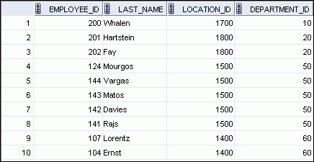
Natural Joins with the USING Clause
SELECT employee_id, last_name,
location_id, department_id
FROM employees JOIN departments
USING (department_id) ;
( ) are required
The common column
Notes:
Retrieving Records with the USING Clause
In the example in the slide, the DEPARTMENT_ID columns in the EMPLOYEES and DEPARTMENTS tables are joined and thus the LOCATION_ID of the department where an employee works is shown.

Slide 16
INNER JOIN The word “INNER” is optional.
SELECT employee_id, last_name,
location_id, department_id
FROM employees INNER JOIN departments
USING (department_id) ;
INNER is part of Oracle SQL
But not ANSI SQL
Notes:
Retrieving Records with the USING Clause
In the example in the slide, the DEPARTMENT_ID columns in the EMPLOYEES and DEPARTMENTS tables are joined and thus the LOCATION_ID of the department where an employee works is shown.

Slide 17
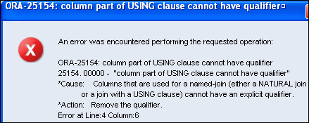
Table Aliases with the USING Clause
Like NAUTRAL JOIN--Do not qualify the common column.
SELECT l.city, d.department_name
FROM locations l JOIN departments d
USING (location_id)
WHERE d.location_id = 1400;
Notes:
Using Table Aliases with the USING clause
When joining with the USING clause, you cannot qualify a column that is used in the USING clause itself. Furthermore, if that column is used anywhere in the SQL statement, you cannot alias it. For example, in the query mentioned in the slide, you should not alias the location_id column in the WHERE clause because the column is used in the USING clause.
The columns that are referenced in the USING clause should not have a qualifier (table name or alias) anywhere in the SQL statement. For example, the following statement is valid:
SELECT l.city, d.department_name
FROM locations l JOIN departments d USING (location_id)
WHERE location_id = 1400;
Because, other columns that are common in both the tables, but not used in the USING clause, must be prefixed with a table alias otherwise you get the “column ambiguously defined” error.
In the following statement, manager_id is present in both the employees and departments table and if manager_id is not prefixed with a table alias, it gives a “column ambiguously defined” error.
The following statement is valid:
SELECT first_name, d.department_name, d.manager_id
FROM employees e JOIN departments d USING (department_id)
WHERE department_id = 50;

Slide 18
Natural Joins with the ON Clause
The common columns do not have to have the same name.
This is the most flexible and widely used form of the NATURAL JOIN clauses
Notes:
Creating Joins with the ON Clause
Use the ON clause to specify a join condition. With this, you can specify join conditions separate from any search or filter conditions in the WHERE clause.

Slide 19
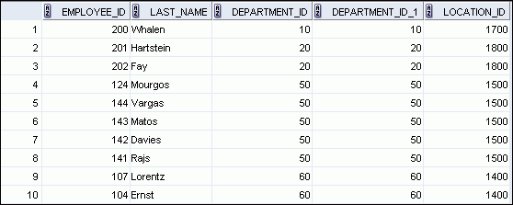
Natural Joins with the ON Clause
SELECT e.employee_id, e.last_name, e.department_id,
d.department_id, d.location_id
FROM employees e JOIN departments d
ON (e.department_id = d.department_id);
…
Notes:
Retrieving Records with the ON Clause
In this example, the DEPARTMENT_ID columns in the EMPLOYEES and DEPARTMENTS table are joined using the ON clause. Wherever a department ID in the EMPLOYEES table equals a department ID in the DEPARTMENTS table, the row is returned. The table alias is necessary to qualify the matching column_names.
You can also use the ON clause to join columns that have different names. The parenthesis around the joined columns as in the slide example, (e.department_id = d.department_id) is optional. So, even ON e.department_id = d.department_id will work.
Note: SQL Developer suffixes a ‘_1’ to differentiate between the two department_ids.

Slide 20
Another example with the ON Clause
SELECT c.country_name
FROM countries c INNER JOIN regions r
ON c.region_id = r.region_id
WHERE r.region_name = ‘Americas’;
The word INNER is optional (for Oracle SQL) but not ANSI SQL
Notes:
Retrieving Records with the ON Clause
In this example, the DEPARTMENT_ID columns in the EMPLOYEES and DEPARTMENTS table are joined using the ON clause. Wherever a department ID in the EMPLOYEES table equals a department ID in the DEPARTMENTS table, the row is returned. The table alias is necessary to qualify the matching column_names.
You can also use the ON clause to join columns that have different names. The parenthesis around the joined columns as in the slide example, (e.department_id = d.department_id) is optional. So, even ON e.department_id = d.department_id will work.
Note: SQL Developer suffixes a ‘_1’ to differentiate between the two department_ids.

Slide 21
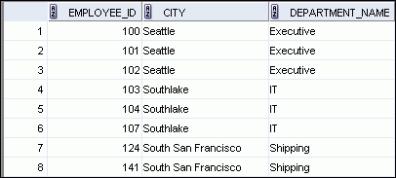
Joining more than 2 tables with the ON Clause
SELECT employee_id, l.city, d.department_name
FROM employees e
JOIN departments d
ON d.department_id = e.department_id
JOIN locations l
ON d.location_id = l.location_id;
…
Notes:
Creating Three-Way Joins with the ON Clause
A three-way join is a join of three tables. In SQL:1999–compliant syntax, joins are performed from left to right. So, the first join to be performed is EMPLOYEES JOIN DEPARTMENTS. The first join condition can reference columns in EMPLOYEES and DEPARTMENTS but cannot reference columns in LOCATIONS. The second join condition can reference columns from all three tables.
Note: The code example in the slide can also be accomplished with the USING clause:
SELECT e.employee_id, l.city, d.department_name
FROM employees e
JOIN departments d
USING (department_id)
JOIN locations l
USING (location_id)

Slide 22
Applying Additional Conditions to a Join
Use the AND clause or the WHERE clause to apply additional conditions:
SELECT e.employee_id, e.last_name, e.department_id,
d.department_id, d.location_id
FROM employees e JOIN departments d
ON (e.department_id = d.department_id)
AND e.manager_id = 149 ;
Or
SELECT e.employee_id, e.last_name, e.department_id,
d.department_id, d.location_id
FROM employees e JOIN departments d
ON (e.department_id = d.department_id)
WHERE e.manager_id = 149 ;
Notes:
Applying Additional Conditions to a Join
You can apply additional conditions to the join.
The example shown performs a join on the EMPLOYEES and DEPARTMENTS tables and, in addition, displays only employees who have a manager ID of 149. To add additional conditions to the ON clause, you can add AND clauses. Alternatively, you can use a WHERE clause to apply additional conditions.

Slide 23
Lesson Agenda
Types of JOINS and its syntax
Natural join:
NATURAL JOIN clause
USING clause
ON clause
Self-join
Nonequijoins
OUTER join:
LEFT OUTER join
RIGHT OUTER join
FULL OUTER join
Cartesian product
Cross join

Slide 24
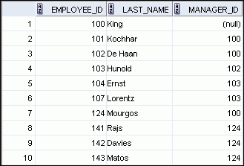
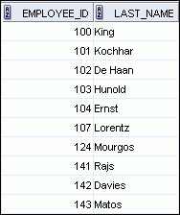
Self-join: Joining a Table to Itself
EMPLOYEES (WORKER)
EMPLOYEES (MANAGER)
…
…
SELECT worker.last_name emp, manager.last_name mgr
FROM employees worker JOIN employees manager
ON (worker.manager_id = manager.employee_id);
Notes:
Joining a Table to Itself
Sometimes you need to join a table to itself. To find the name of each employee’s manager, you need to join the EMPLOYEES table to itself, or perform a self-join. For example, to find the name of Lorentz’s manager, you need to:
Find Lorentz in the EMPLOYEES table by looking at the LAST_NAME column
Find the manager number for Lorentz by looking at the MANAGER_ID column. Lorentz’s manager number is 103.
Find the name of the manager with EMPLOYEE_ID 103 by looking at the LAST_NAME column. Hunold’s employee number is 103, so Hunold is Lorentz’s manager.
In this process, you look in the table twice. The first time you look in the table to find Lorentz in the LAST_NAME column and the MANAGER_ID value of 103. The second time you look in the EMPLOYEE_ID column to find 103 and the LAST_NAME column to find Hunold.

Slide 25
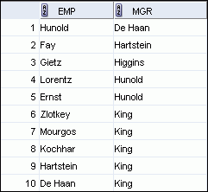
Self-Joins Using the ON Clause
SELECT worker.last_name emp, manager.last_name mgr
FROM employees worker JOIN employees manager
ON (worker.manager_id = manager.employee_id);
…
Notes:
Self-Joins Using the ON Clause
The ON clause can also be used to join columns that have different names, within the same table or in a different table.
The example shown is a self-join of the EMPLOYEES table, based on the EMPLOYEE_ID and MANAGER_ID columns.
Note: The parenthesis around the joined columns as in the slide example, (e.manager_id = m.employee_id) is optional. So, even ON e.manager_id = m.employee_id will work.

Slide 26
Lesson Agenda
Types of JOINS and its syntax
Natural join:
USING clause
ON clause
Self-join
Nonequijoins
OUTER join:
LEFT OUTER join
RIGHT OUTER join
FULL OUTER join
Cartesian product
Cross join

Slide 27
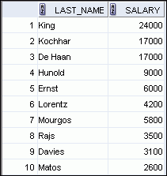
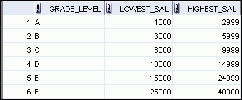

Nonequijoins
EMPLOYEES
JOB_GRADES
JOB_GRADES table defines the LOWEST_SAL and HIGHEST_SAL range of values for each GRADE_LEVEL. Hence, the GRADE_LEVEL column can be used to assign grades to each employee.
…
Notes:
Nonequijoins
A nonequijoin is a join condition containing something other than an equality operator.
The relationship between the EMPLOYEES table and the JOB_GRADES table is an example of a nonequijoin. The SALARY column in the EMPLOYEES table ranges between the values in the LOWEST_SAL and HIGHEST_SAL columns of the JOB_GRADES table. Therefore, each employee can be graded based on their salary. The relationship is obtained using an operator other than the equality (=) operator.

Slide 28
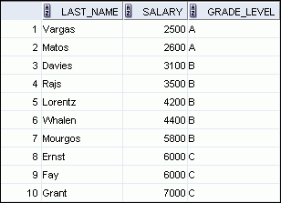
Retrieving Records with Nonequijoins
SELECT e.last_name, e.salary, j.grade_level
FROM employees e JOIN job_grades j
ON e.salary
BETWEEN j.lowest_sal AND j.highest_sal;
…
Notes:
Retrieving Records with Nonequijoins
The slide example creates a nonequijoin to evaluate an employee’s salary grade. The salary must be between any pair of the low and high salary ranges.
It is important to note that all employees appear exactly once when this query is executed. No employee is repeated in the list. There are two reasons for this:
None of the rows in the JOB_GRADES table contain grades that overlap. That is, the salary value for an employee can lie only between the low salary and high salary values of one of the rows in the salary grade table.
All of the employees’ salaries lie within the limits provided by the job grade table. That is, no employee earns less than the lowest value contained in the LOWEST_SAL column or more than the highest value contained in the HIGHEST_SAL column.
Note: Other conditions (such as <= and >=) can be used, but BETWEEN is the simplest. Remember to specify the low value first and the high value last when using the BETWEEN condition. The Oracle server translates the BETWEEN condition to a pair of AND conditions. Therefore, using BETWEEN has no performance benefits, but should be used only for logical simplicity.
Table aliases have been specified in the slide example for performance reasons, not because of possible ambiguity.

Slide 29
Lesson Agenda
Types of JOINS and its syntax
Natural join:
USING clause
ON clause
Self-join
Nonequijoins
OUTER join:
LEFT OUTER join
RIGHT OUTER join
FULL OUTER join
Cartesian product
Cross join

Slide 30
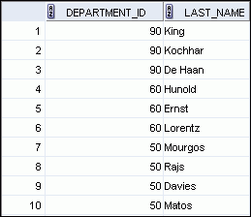
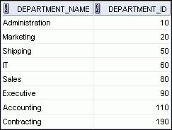

Returning orphans (records with missing data) Using OUTER Joins
EMPLOYEES
DEPARTMENTS
…
There are no employees in department 190.
Grant
Employee “Grant” has not been assigned a department ID.
Notes:
Returning Records with No Direct Match Using OUTER Joins
If a row does not satisfy a join condition, the row does not appear in the query result.
In the slide example, a simple equijoin condition is used on the EMPLOYEES and DEPARTMENTS tables to return the result on the right. The result set does not contain the following:
Department ID 190, because there are no employees with that department ID recorded in the EMPLOYEES table
The employee with the last name of Grant, because this employee has not been assigned a department ID
To return the department record that does not have any employees, or employees that do not have an assigned department, you can use an OUTER join.

Slide 31
INNER Versus OUTER Joins
In SQL:1999, the join of two tables returning only matched rows is called an INNER join.
LEFT OUTER join returns orphans from the left-hand table
RIGHT OUTER join returns orphans from the right-hand table
Notes:
INNER Versus OUTER Joins
Joining tables with the NATURAL JOIN, USING, or ON clauses results in an INNER join. Any unmatched rows are not displayed in the output. To return the unmatched rows, you can use an OUTER join. An OUTER join returns all rows that satisfy the join condition and also returns some or all of those rows from one table for which no rows from the other table satisfy the join condition.
There are three types of OUTER joins:
LEFT OUTER
RIGHT OUTER
FULL OUTER

Slide 32
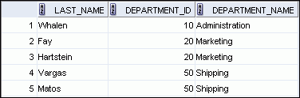

LEFT OUTER JOIN
SELECT e.last_name, e.department_id, d.department_name
FROM employees e LEFT OUTER JOIN departments d
ON (e.department_id = d.department_id) ;
…
Orphan from Employees table (left)
Notes:
LEFT OUTER JOIN
This query retrieves all the rows in the EMPLOYEES table, which is the left table, even if there is no match in the DEPARTMENTS table.

Slide 33


RIGHT OUTER JOIN
SELECT e.last_name, d.department_id, d.department_name
FROM employees e RIGHT OUTER JOIN departments d
ON (e.department_id = d.department_id) ;
…
Orphan from Departments table (right)
Notes:
RIGHT OUTER JOIN
This query retrieves all the rows in the DEPARTMENTS table, which is the table at the right, even if there is no match in the EMPLOYEES table.

Slide 34

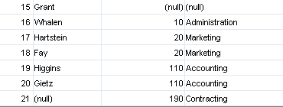
FULL OUTER JOIN
SELECT e.last_name, d.department_id, d.department_name
FROM employees e FULL OUTER JOIN departments d
ON (e.department_id = d.department_id) ;
…
Orphans from both tables (left & right)
Notes:
FULL OUTER JOIN
This query retrieves all rows in the EMPLOYEES table, even if there is no match in the DEPARTMENTS table. It also retrieves all rows in the DEPARTMENTS table, even if there is no match in the EMPLOYEES table.

Slide 35
Lesson Agenda
Types of JOINS and its syntax
Natural join:
USING clause
ON clause
Self-join
Nonequiijoin
OUTER join:
LEFT OUTER join
RIGHT OUTER join
FULL OUTER join
Cartesian product
Cross join

Slide 36
Cartesian Products
A Cartesian product is formed when:
A join condition is omitted or invalid
The CROSS JOIN clause is used
All rows in the first table are joined to all rows in the second table
If there are 100 rows in the first table, and 20 in the second, the cross product will generate 2000 rows
It usually is not a desired outcome.
To avoid a Cartesian product, always include a valid join condition.
Notes:
Cartesian Products
When a join condition is invalid or omitted completely, the result is a Cartesian product, in which all combinations of rows are displayed. All rows in the first table are joined to all rows in the second table.
A Cartesian product tends to generate a large number of rows and the result is rarely useful. You should, therefore, always include a valid join condition unless you have a specific need to combine all rows from all tables.
However, Cartesian products are useful for some tests when you need to generate a large number of rows to simulate a reasonable amount of data.

Slide 37
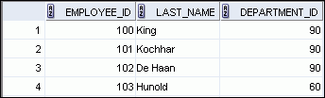

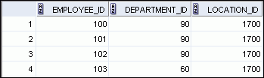

Example of a Cartesian Product
EMPLOYEES (20 rows)
DEPARTMENTS (8 rows)
…
Cartesian product: 20 x 8 = 160 rows
…
Notes:
Generating a Cartesian Product
A Cartesian product is generated if a join condition is omitted. The example in the slide displays the employee last name and the department name from the EMPLOYEES and DEPARTMENTS tables. Because no join condition was specified, all rows (20 rows) from the EMPLOYEES table are joined with all rows (8 rows) in the DEPARTMENTS table, thereby generating 160 rows in the output.

Slide 38
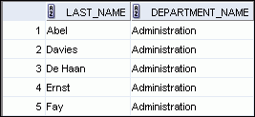

Creating Cross Joins
The CROSS JOIN clause produces the cross-product of two tables.
This is also called a Cartesian product
SELECT last_name, department_name
FROM employees
CROSS JOIN departments ;
…
Notes:
Creating Cross Joins
The example in the slide produces a Cartesian product of the EMPLOYEES and DEPARTMENTS tables.

Slide 39
Quiz
The SQL:1999 standard join syntax supports the following types of joins. Which of these join types does Oracle join syntax support?
Equijoins
Nonequijoins
Left OUTER join
Right OUTER join
Full OUTER join
Self joins
Natural joins
Cartesian products
Notes:
Answer: 1, 2, 3, 4, 6, 8

Slide 40
Summary
In this lesson, you should have learned how to use joins to display data from multiple tables by using:
Equijoins
Nonequijoins
OUTER joins
Self-joins
Cross joins
Natural joins
Full (or two-sided) OUTER joins
Notes:
Summary
There are multiple ways to join tables.
Types of Joins
Equijoins
Nonequijoins
OUTER joins
Self-joins
Cross joins
Natural joins
Full (or two-sided) OUTER joins
Cartesian Products
A Cartesian product results in the display of all combinations of rows. This is done by either omitting the WHERE clause or by specifying the CROSS JOIN clause.
Table Aliases
Table aliases speed up database access.
Table aliases can help to keep SQL code smaller by conserving memory.
Table aliases are sometimes mandatory to avoid column ambiguity.

Slide 41
Practice 6: Overview
This practice covers the following topics:
Joining tables using an equijoin
Performing outer and self-joins
Adding conditions
Notes:
Practice 6: Overview
This practice is intended to give you experience in extracting data from more than one table using the SQL:1999–compliant joins.

Slide 42
Notes:
Practice 6
1. Write a query for the HR department to produce the addresses of all the departments. Use the LOCATIONS and COUNTRIES tables. Show the location ID, street address, city, state or province, and country in the output. Use a NATURAL JOIN to produce the results.
2. The HR department needs a report of all employees. Write a query to display the last name, department number, and department name for all the employees.
…

Slide 43
Notes:
Practice 6 (continued)
The HR department needs a report of employees in Toronto. Display the last name, job, department number, and the department name for all employees who work in Toronto.
4. Create a report to display employees’ last name and employee number along with their manager’s last name and manager number. Label the columns Employee, Emp#, Manager, and Mgr#, respectively. Save your SQL statement as lab_06_04.sql. Run the query.
…

Slide 44
Notes:
Practice 6 (continued)
5. Modify lab_06_04.sql to display all employees including King, who has no manager. Order the results by the employee number. Save your SQL statement as lab_06_05.sql. Run the query in lab_06_05.sql.
6. Create a report for the HR department that displays employee last names, department numbers, and all the employees who work in the same department as a given employee. Give each column an appropriate label. Save the script to a file named lab_06_06.sql.
…
…

Slide 45
Notes:
Practice 6 (continued)
7. The HR department needs a report on job grades and salaries. To familiarize yourself with the JOB_GRADES table, first show the structure of the JOB_GRADES table. Then create a query that displays the name, job, department name, salary, and grade for all employees.
…

Slide 46
Notes:
Practice 6 (continued)
If you want an extra challenge, complete the following exercises:
8. The HR department wants to determine the names of all the employees who were hired after Davies. Create a query to display the name and hire date of any employee hired after employee Davies.
9. The HR department needs to find the names and hire dates of all the employees who were hired before their managers, along with their managers’ names and hire dates. Save the script to a file named lab_06_09.sql.

